Slide 1
ARTIFICIAL NEURAL NETWORKS REGRESSION

Slide 2
ARTIFICIAL NEURAL NETWORKS REGRESSION
Regression ANNs predict an output variable as a function of the inputs. The input features (independent variables) can be categorical or numeric types, however, for regression ANNs, we require a numeric dependent variable.

Slide 3
PERCEPTRON
A Perceptron is a neural network unit that does certain computations to detect features or business intelligence in the input data. It is a function that maps its input “x,” which is multiplied by the learned weight coefficient, and generates an output value ”f(x)

Slide 4
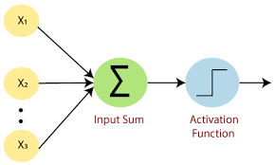
PERCEPTRON
Xi = inputs
Summation(z) = W.Xi +b
Activation function = f(x)

Slide 5
Limitations of perceptron
It classifies only linear or sort of linear data.
For nonlinear data the perceptron trick will fail.
It is nothing but a line, it classifies two regions with two classes.

Slide 6
ACTIVATION FUNCTIONS FOR REGRESSION
Linear f(z) = (az)
its range is -infinity to +infinity
Relu f(z) = Max(0,Z)
its range is 0 to infinity

Slide 7
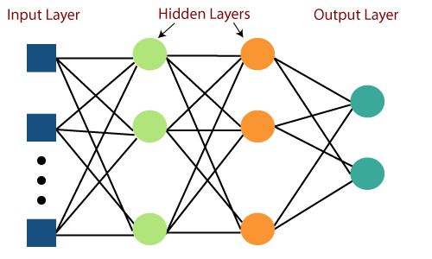
MULTILAYER PERCEPTRON
Multi layer perceptron (MLP) is a supplement of feed forward neural network. It consists of three types of layers—the input layer, output layer and hidden layer

Slide 8
FOrWARD PROPAGATION : a1 = w1*x1 + w2*x2 + b1 Here, h1 is the value of the activation function applied on a1. for any layer after the first hidden layer, the input is output from the previous layer.

Slide 9
LOSS FUNCTION IN ANN
A loss function is a function that compares the target and predicted output values; measures how well the neural network models the training data.
MSE(mean squared error)
L = (Yi – Y ^)**2
MAE(mean absolute error)
L = |Yi-Y^|

Slide 10
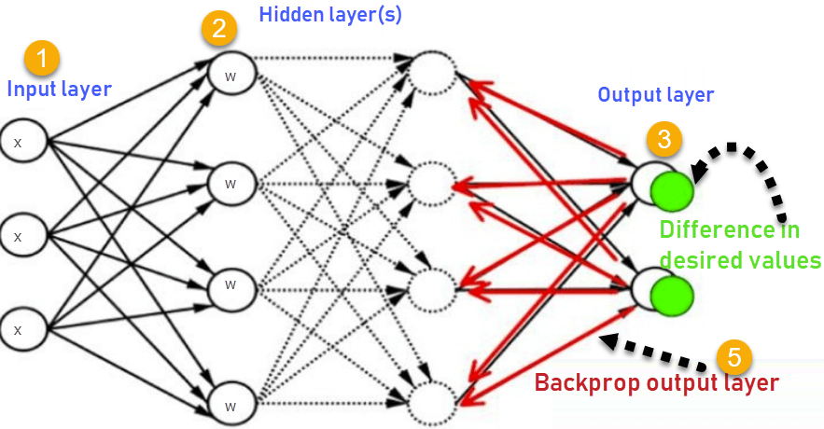
BACK PROPAGATION
Backpropagation, or backward propagation of errors, is an algorithm that is designed to test for errors working back from output nodes to input nodes.

Slide 11
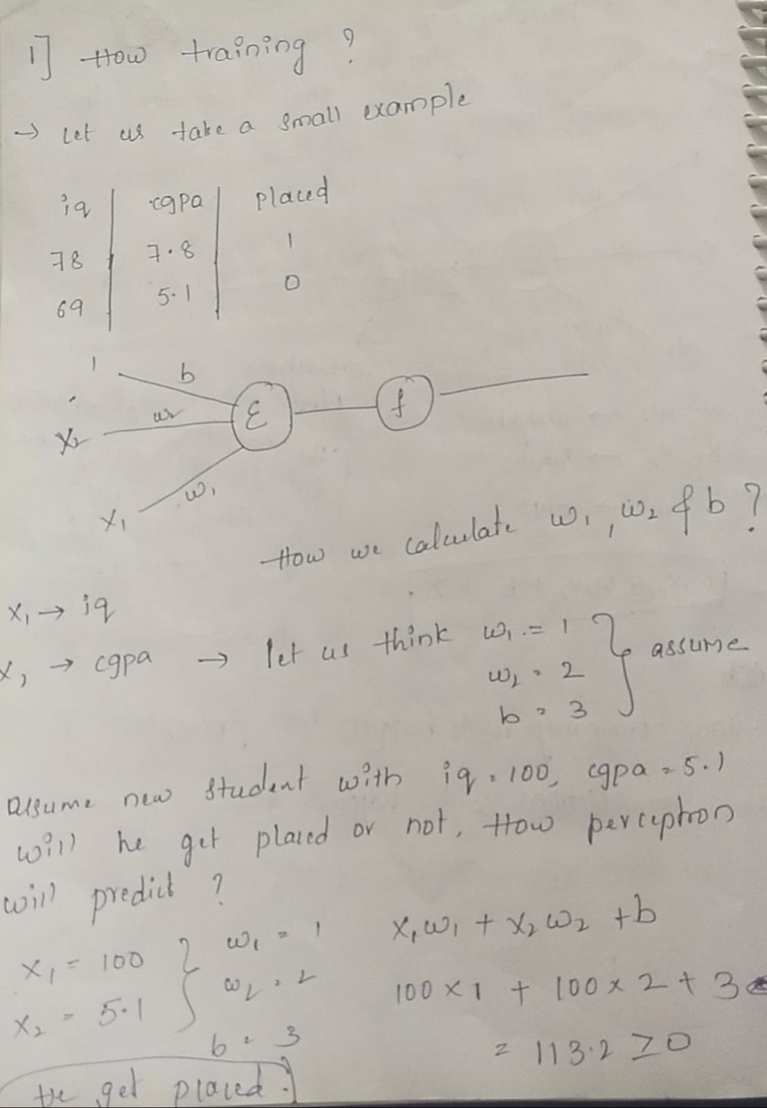

Slide 12
Gradient descent techniques for ann
It is an optimization algorithm applied to model training. Gradient Descent, to put it simply, identifies the variables that minimize the cost function (error in prediction).
Batch gradient descent
Stochastic gradient descent
Mini batch gradient descent

Slide 13
THANK YOU RAGHUNATH REDDY EDULA Batch : 130

